Slide 1



Slide 2
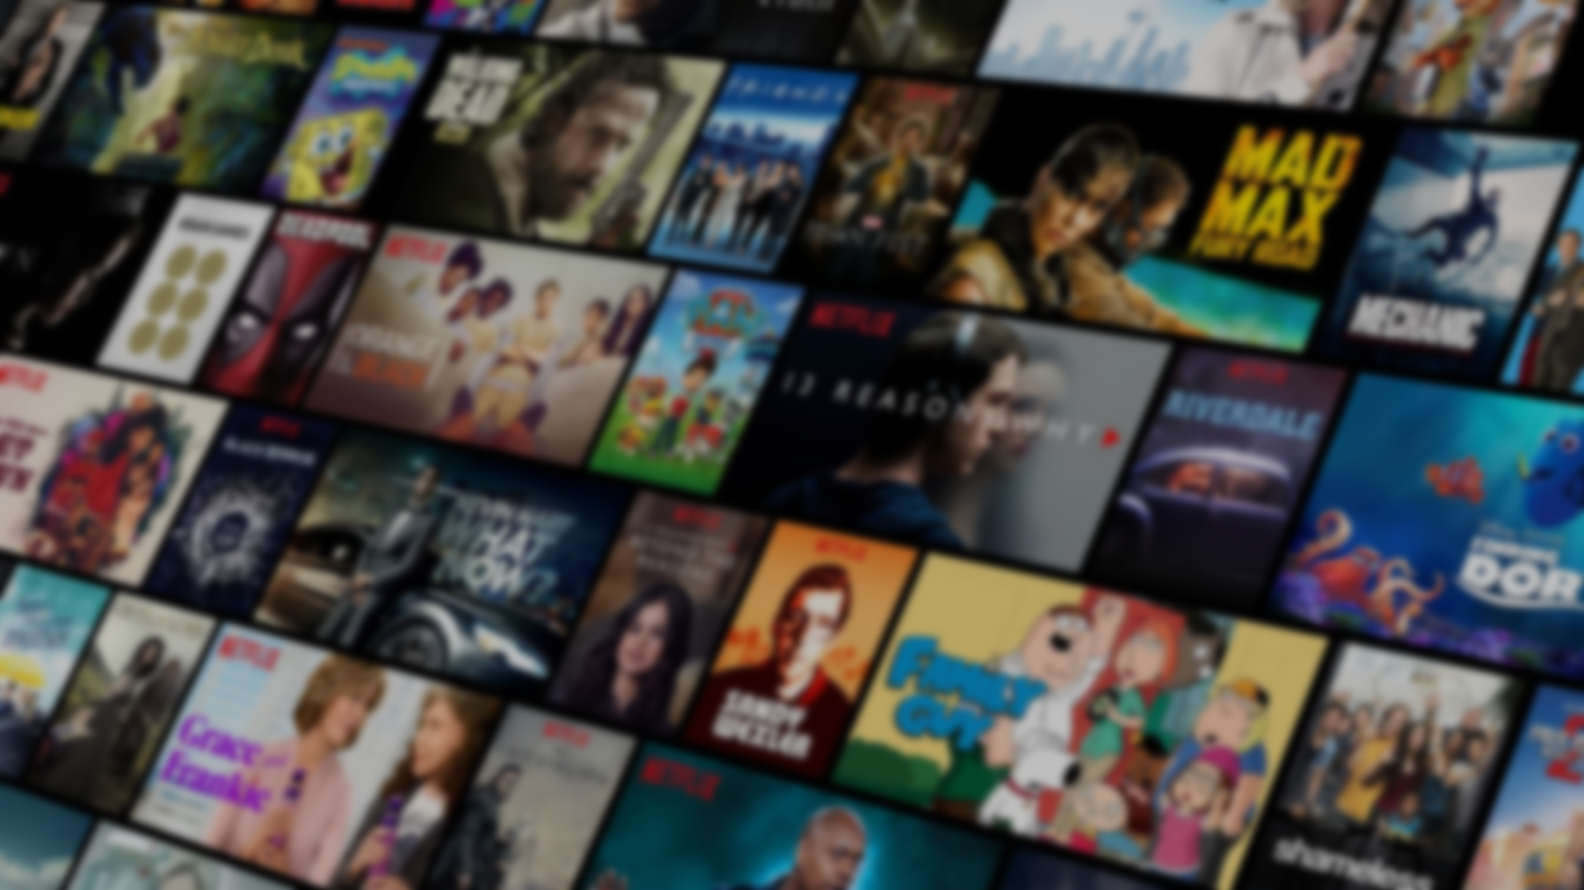

Slide 3














Home
Tv Shows
Movies
Latest
My List
Browse by Languages
Continue Watching
introduction
Our Objective
Business Questions
Notes:
2

Slide 4



Home
Business Questions
Latest
My List
Browse by Languages
As a data analyst, my mission is to develop a comprehensive report that provides valuable insights into Netflix’s content library. The report aims to analyze and visualize the distribution of content types (Movies vs. TV Shows), titles, directors, and cast members. These insights will enable Netflix’s strategic team to understand content trends, identify gaps, and make informed decisions on content acquisition and production to maintain a competitive edge in the streaming market
Our Mission
My vision is to craft an engaging and insightful Netflix Content Analysis Report that not only presents data in an easy-to-understand manner but also tells a story about Netflix's content strategy and its influence on viewer engagement. The report will focus on creating an interactive experience for the users, leveraging modern data visualization techniques to deliver both a macro and micro perspective of Netflix's content library
Our Vision
Our Mission And Vision

Slide 5
Home
Business Questions
Our stats
Account
Settings
Sign Out
Business Questions
Content Distribution
Seasonal Additions
Genre Analysis
Global Netflix Subscriptions
Country-Based Availability
Yearly Title Growth
Content Ratings
Director Consistency
Optimizing Netflix Recommendations Using Cast Insights
subscription plan

Slide 6
Home
Business Questions
Our stats
Account
Settings
Sign Out
Content Distribution
To inform strategic content acquisition and marketing efforts, we can analyze the content distribution, revealing the percentage of Netflix’s library comprised of TV shows versus movies, thereby guiding decisions on future investments in content.

Slide 7
Home
Business Questions
Our stats
Account
Settings
Sign Out
Seasonal Additions
Understanding the seasonal trends in TV show additions allows for better content planning and marketing campaigns, ensuring that Netflix optimally aligns its releases with viewer engagement patterns throughout the year.

Slide 8
Home
Business Questions
Our stats
Account
Settings
Sign Out
Genre Analysis
A genre analysis can inform strategic partnerships with creators and production companies, enabling Netflix to strengthen its offerings in high-demand categories, thus attracting a broader audience.

Slide 9
Home
Business Questions
Our stats
Account
Settings
Sign Out
Global Netflix Subscriptions
focusing on understanding the distribution of subscriptions across different countries and exploring whether there is any relationship between the number of subscriptions and the available content (library size)

Slide 10
Home
Business Questions
Our stats
Account
Settings
Sign Out
Country-Based Availability
Mapping the availability of content by country helps in evaluating market saturation and identifying opportunities for regional expansion, ultimately informing localized marketing strategies.

Slide 11
Home
Business Questions
Our stats
Account
Settings
Sign Out
Yearly Title Growth
A historical analysis of title additions over time reveals growth trends and informs strategic planning for content development, ensuring that Netflix remains competitive in a rapidly evolving market.

Slide 12
Home
Business Questions
Our stats
Account
Settings
Sign Out
Content Ratings
Understanding the distribution of content ratings aids in compliance with regional regulations and enhances content curation strategies to meet audience expectations and preferences.

Slide 13
Home
Business Questions
Our stats
Account
Settings
Sign Out
Director Consistency
Identifying successful directors with a proven track record allows Netflix to establish and nurture strategic relationships, potentially securing exclusive content that appeals to target demographics.

Slide 14
Home
Business Questions
Our stats
Account
Settings
Sign Out
Optimizing Netflix Recommendations Using Cast Insights
Netflix can use data on cast members with the most appearances to improve content recommendations by suggesting more shows and movies featuring these actors to viewers who enjoy their work. This personalization increases engagement, as users are more likely to watch content with actors they recognize and enjoy. Additionally, Netflix can promote these popular cast members in marketing campaigns to further drive viewership

Slide 15
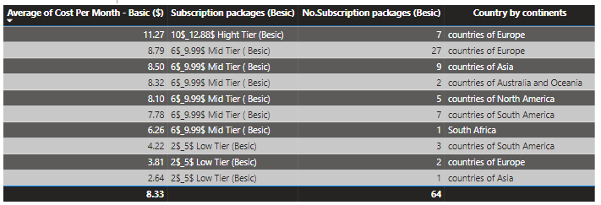
Home
Business Questions
Our stats
Account
Settings
Sign Out
subscription plan
By determining which Netflix subscription plan (Basic, Standard, Premium) is the most prevalent across different continents for each tier, we can understand regional preferences. This helps in assessing if certain regions favor more affordable plans (like Basic) or if they prefer plans with higher features (like Standard or Premium).

Slide 16

Home
Business Questions
Our stats
Account
Settings
Sign Out
don’t hesitate to ask me any questions

Slide 17


THANK YOU
Hossam
Ahmed

